Slide 1
Looking Back – Living Forward
Lessons for today, learned from Old Testament Prophets

Slide 2
Looking Back – Living Forward
Lessons for today, learned from Old Testament Prophets
May 1st – Kirk Franklin
Jeremiah part 1

Slide 3
Looking Back – Living Forward
Jeremiah
‘Major’ Prophets | ‘Minor’ Prophets [i.e., shorter, not less important]
Isaiah, Jeremiah, Ezekiel, Daniel | Hosea, Joel, Amos, Obadiah, Jonah, Micah, Nahum, Habakkuk, Zephaniah, Haggai, Zechariah, Malachi

Slide 4
Looking Back – Living Forward
Jeremiah
We learn more about Jeremiah then most OT prophets:
> Where he was from: ‘These are the words of Jeremiah son of Hilkiah, one of the priests from the town of Anathoth in the land of Benjamin’ (1:1)
> Threats and brushes with death: ‘This is what the Lord says about the men of Anathoth who wanted me [Jeremiah] dead. They had said, “We will kill you if you do not stop prophesying in the Lord’s name”’ (11:21)
> Opposition from false prophets: [in a letter from Shemaiah to Zephaniah] ‘So why have you done nothing to stop Jeremiah from Anathoth, who pretends to be a prophet among you?’ (29:27)

Slide 5
Looking Back – Living Forward
Jeremiah
Old Testament prophets:
Spoke for God to their contemporaries
Spoke beforehand and foretold for God
Responded to a call and appointment directly from God
Spoke God’s message as an individual event, not a stereotyped formula

Slide 6
Looking Back – Living Forward
Jeremiah
Known before birth, God’s intentions are clear:
Jeremiah (1:5)
‘Before [the Lord] formed you in the womb I knew you, before you were born I set you apart; I appointed you as a prophet to the nations’
Isaiah (49:1)
‘…before I was born the Lord chose me to serve him. He appointed me by name’
David (Ps 139:13-16)
‘[God] created the deepest parts of my being… inside my mother’s body… your eyes saw my body even before it was formed. You planned how many days I would live’
Paul (Gal 1:15)
‘God set me apart from the time I was born. He showed me his grace by appointing me’

Slide 7
Looking Back – Living Forward
Jeremiah
Eugene Peterson:
‘Instead of being told what Jeremiah’s parents were doing, we are told what his God was doing: Long before we ever got around to asking questions about God, God had been questioning us. Before it ever crossed our minds that God might be important, God singled us out as important’
Batandu (DRC):
‘God created us with our nails and our fingers’
Yombe (Congo):
‘God made us from our hair to our toes’

Slide 8
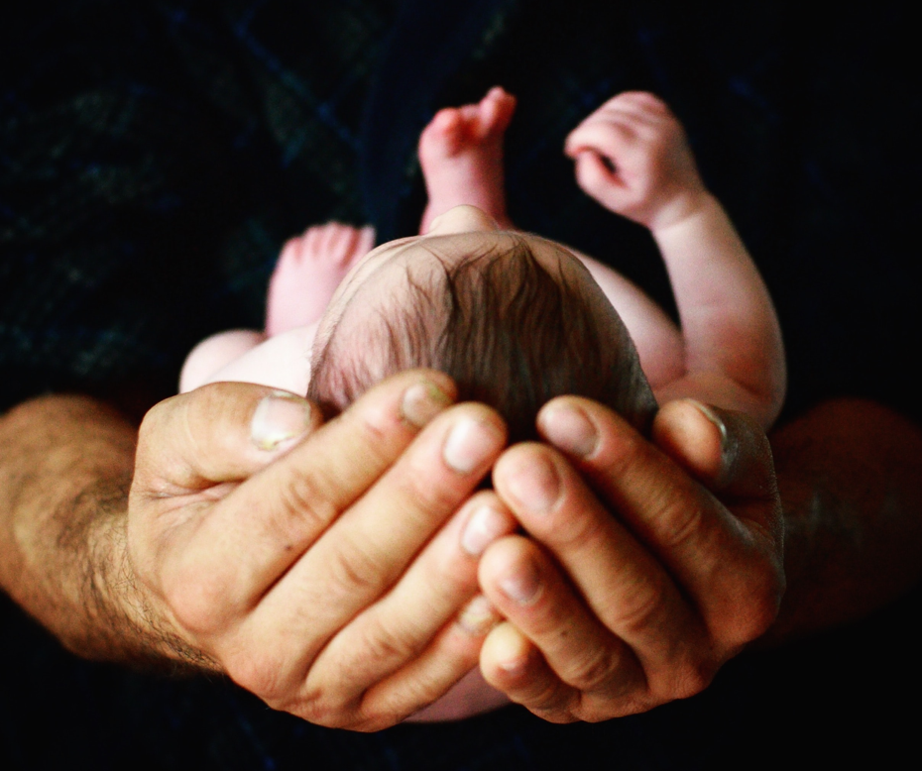
Looking Back – Living Forward
Jeremiah
J. Nelson Jennings:
‘…because of Jeremiah 1:5 [‘before formed you… I knew you, I set you apart, I appointed you…’] and with other verses like it, all of God’s people in Christ, can rest assured of the divine superintendence [oversight] of our calling from all eternity’
Photo by Jill Sauve on Unsplash

Slide 9
Looking Back – Living Forward
Jeremiah
The Calling of a Prophet:
if a prophet assumed the office of prophet without God’s appointment, it meant they were a false prophet
Jeremiah 14:14
Then the Lord said to me, ‘Those prophets are prophesying lies while claiming my authority! I did not send them. I did not commission them. I did not speak to them. They are prophesying to these people false visions, worthless predictions, and the delusions of their own mind’

Slide 10
Looking Back – Living Forward
Jeremiah
The Calling of Jeremiah:
‘O Sovereign Lord,’ I said, ‘I can’t speak for you! I’m too young!’ (1:6)
Youthfulness and inexperience: He was about 18 at the time; too young to be sent into a high-profile public ministry; he believed his youth would hamper his delivering God’s message to a hostile audience
Lack of clear speech and persuasiveness: He knew that to be a prophet he had to be a good public speaker. Moses: ‘I’ve never been a good speaker. And I haven’t gotten any better since you spoke to me’ (Ex 4:10)

Slide 11
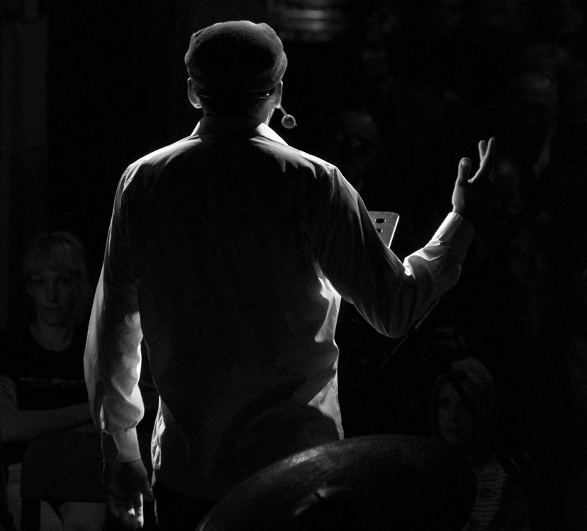
Looking Back – Living Forward
Jeremiah
The Lord’s responds to Jeremiah:
…Then the Lord reached out and touched my mouth and said,
“Look, I have put my words in your mouth!...”
(1:7)
Evidence of God’s empowerment of Jeremiah was through a spiritual experience. He became a mouthpiece for God
Photo by Alberto Bigoni on Unsplash

Slide 12
Looking Back – Living Forward
Jeremiah
God equips his servant:
God gives his message:
‘go wherever I send you and say whatever I tell you… and say whatever I tell you’ (1:7)
God cares:
‘don’t be afraid of the people, for I will be with you and will protect you’ (1:8)
God gives authority:
‘I appoint you to stand up against nations and kingdoms…’ (1:10)
God tears down before rebuilding:
‘Some you must uproot and tear down, destroy and overthrow. Others you must build up and plant’ (1:10)

Slide 13
Looking Back – Living Forward
Jeremiah
God equips his servant:
God sends:
an essential element in Jeremiah’s commis-sioning
To Moses: ‘Now go, for I am sending you to Pharaoh. You must lead my people Israel out of Egypt’ (Ex 3:10) [shaw-lakh'] | To Isaiah: “Whom should I send as a messenger to this people? Who will go for us?” I said, “Here I am. Send me.” (Isa 6:8) [shaw-lakh'] | To Jeremiah: ‘…you must go wherever I send you and say whatever I tell you’ (Jer 1:7) [shaw-lakh']
To Ezekiel: ‘…“I am sending you to the nation of Israel’ (Ezk 2:3) [shaw-lakh'] | ‘…ask him to send more workers into his fields’ (Mt 9:38) [ekbalē] | ‘… he would send [the disciples] out to preach…’ (Mk 3:14) [apostellē]
Jesus ‘called his twelve disciples together and began sending them out two by two…’ (Mk 6:7) [apostellein] | Jesus: ‘And anyone who rejects me is rejecting God, who sent me’ (Lk 10:16) [aposteilanta] | Jesus to disciples: ‘the Father has sent me, so I am sending you’ (Jn 20:21) [apestalken, pempō]

Slide 14
Looking Back – Living Forward
Jeremiah
The assignment from God glorifies God:
God tells Jeremiah, ‘don’t be afraid of the people, for I will be with you and will protect you. I, the Lord, have spoken!’ (1:8)
God accomplishes his plans:
> “I see a branch from an almond tree” = the Lord is watching to make sure what Jeremiah says in God’s name is accomplished (1:11-12)
> “I see a pot of boiling water, spilling from the north” = the coming invasion of Babylon from the north with the purpose of punishing Judah’s idolatry (1:13-14)

Slide 15
Looking Back – Living Forward
Jeremiah
Applications:
God says reconnect with His purpose:
> Are we living fully in that purpose? It’s never too late
> God wants to take us from where we are, to new spaces and sometimes places. What does that look like for you?
God says stay close to Him:
> Are we letting God empower us to overcome obstacles that keep us from flourishing?
> God wants us to return to Him even when we have been wayward. Any behaviours in your life that need attention?
Photo by Joseph Akbrud on Unsplash

